Slide 1

CS-150-Final project
By Sawyer Mason

Slide 2
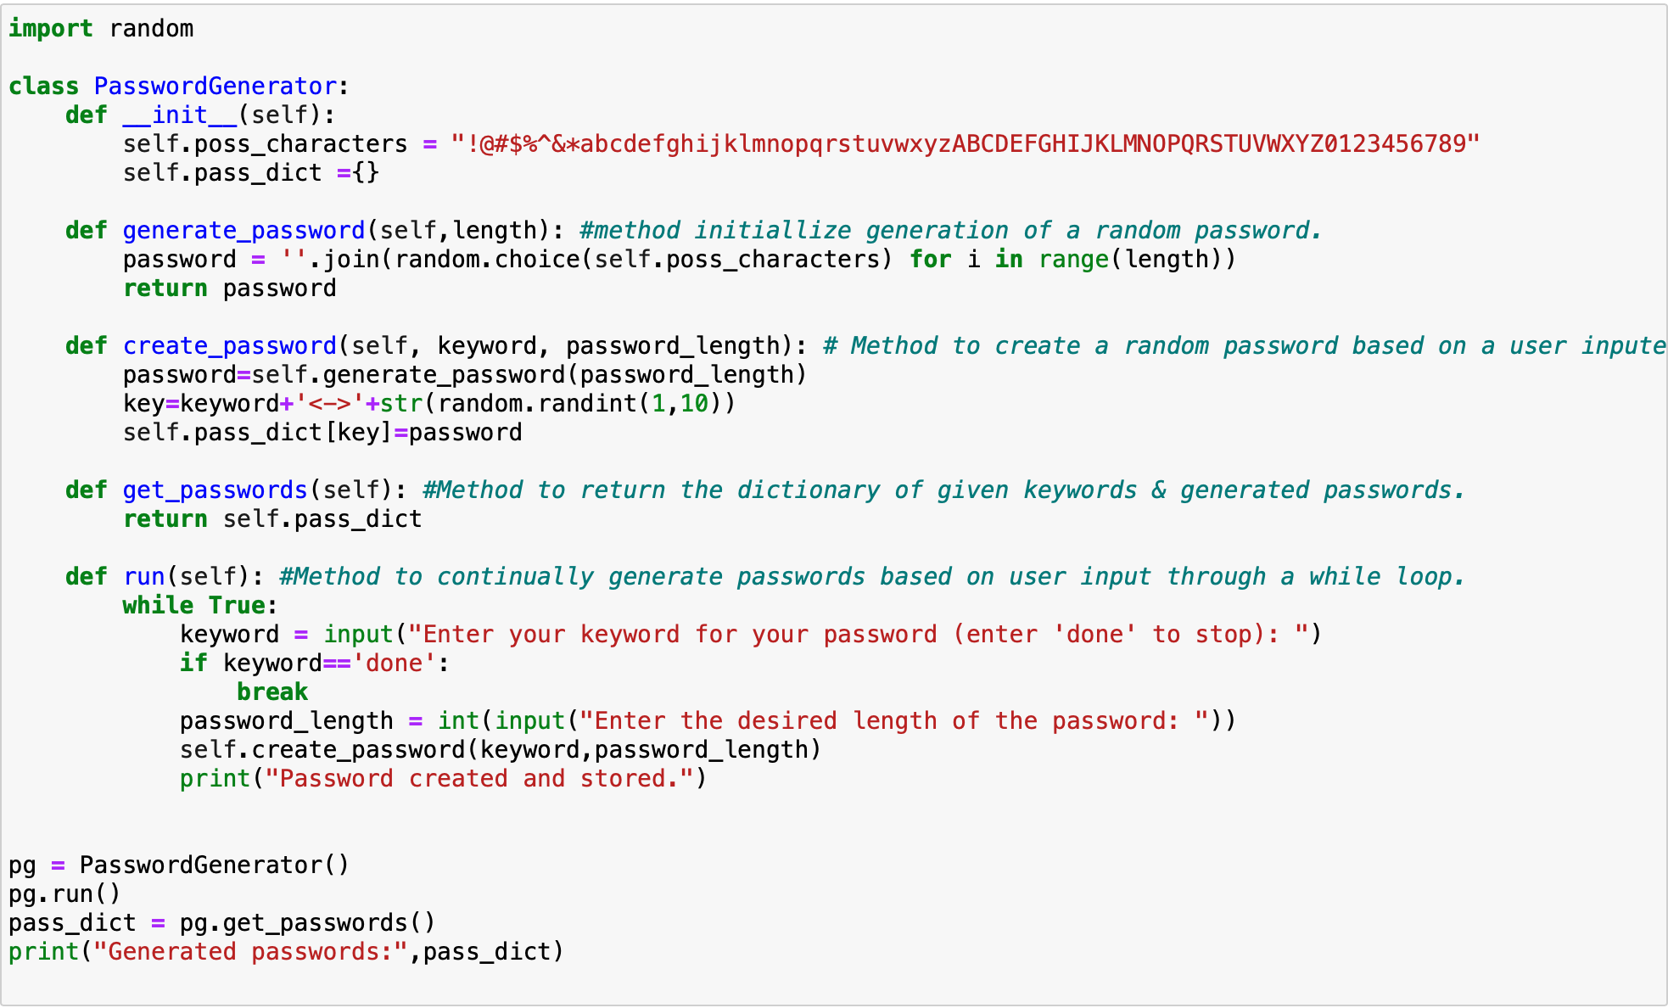
Code overview
Password manager
Random code from a user input
Selectable length
Saves all passwords in a callable dictionary

Slide 3
Class and initialization
Defines entire class
Possible characters for password
Creates initial empty dictionary

Slide 4
Password generation
Method to generate initial password
Uses for loop to generate each random character based on inputted length

Slide 5
Keyword pairing

Slide 6
dictionary
Allows for recall of full dictionary with all passwords and keywords

Slide 7
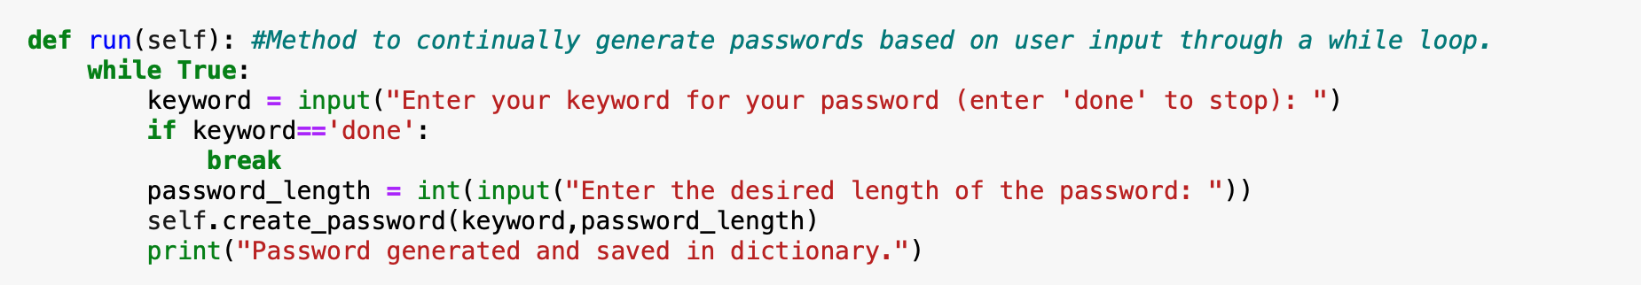
While loop
Enables user to generate multiple passwords at one time
Uses while loop to continue until user enters “done”

Slide 8
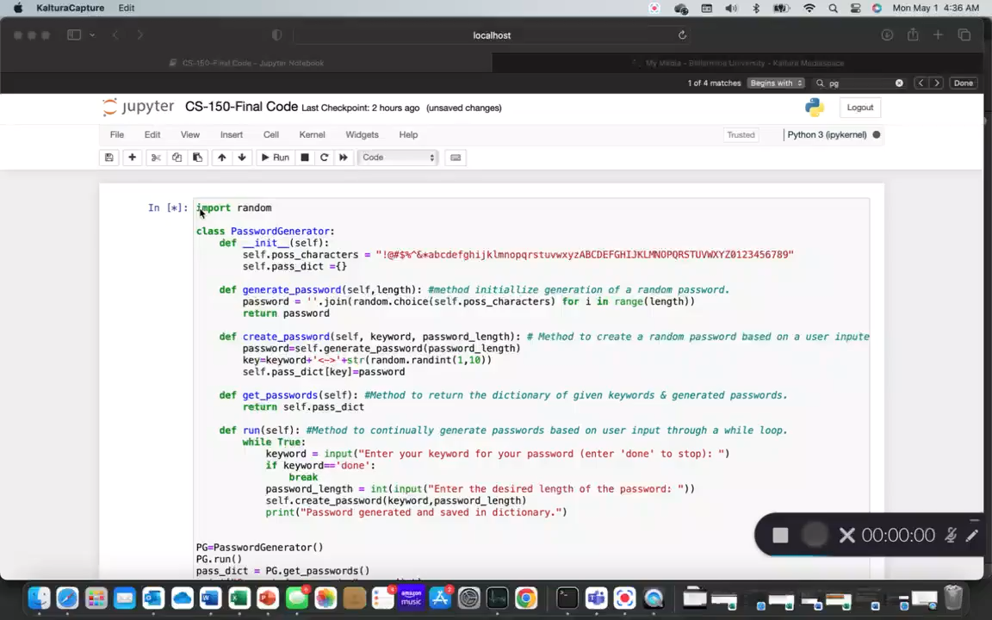
Demonstration Video

Slide 9
Questions?
Thank you for listening.

